Slide 1
Week 8 progress report
Group members
Eunice orenge
Laban mwangi
Stephen kinuthia
Victor ngatia

Slide 2
OBJECTIVES
- Redesign the PCB
- Simulate the circuit
- Consult Nakuja team on where to print the PCB
- Come up with a list of components and their prices

Slide 3
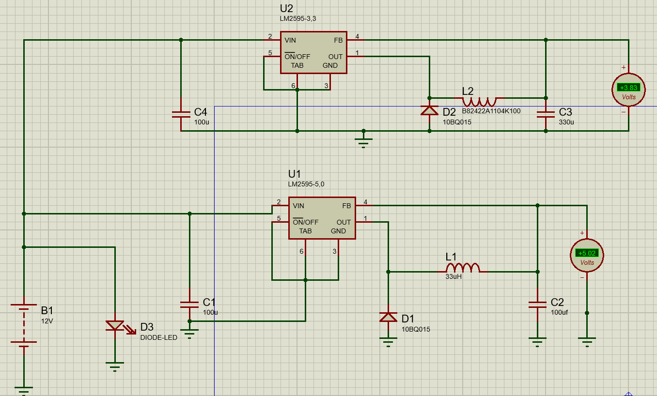
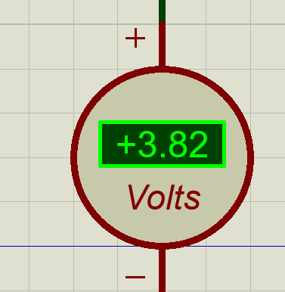
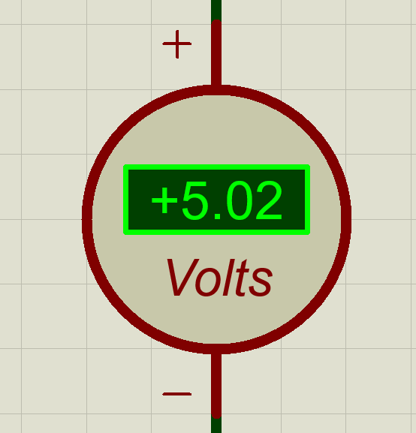
simulation

Slide 4
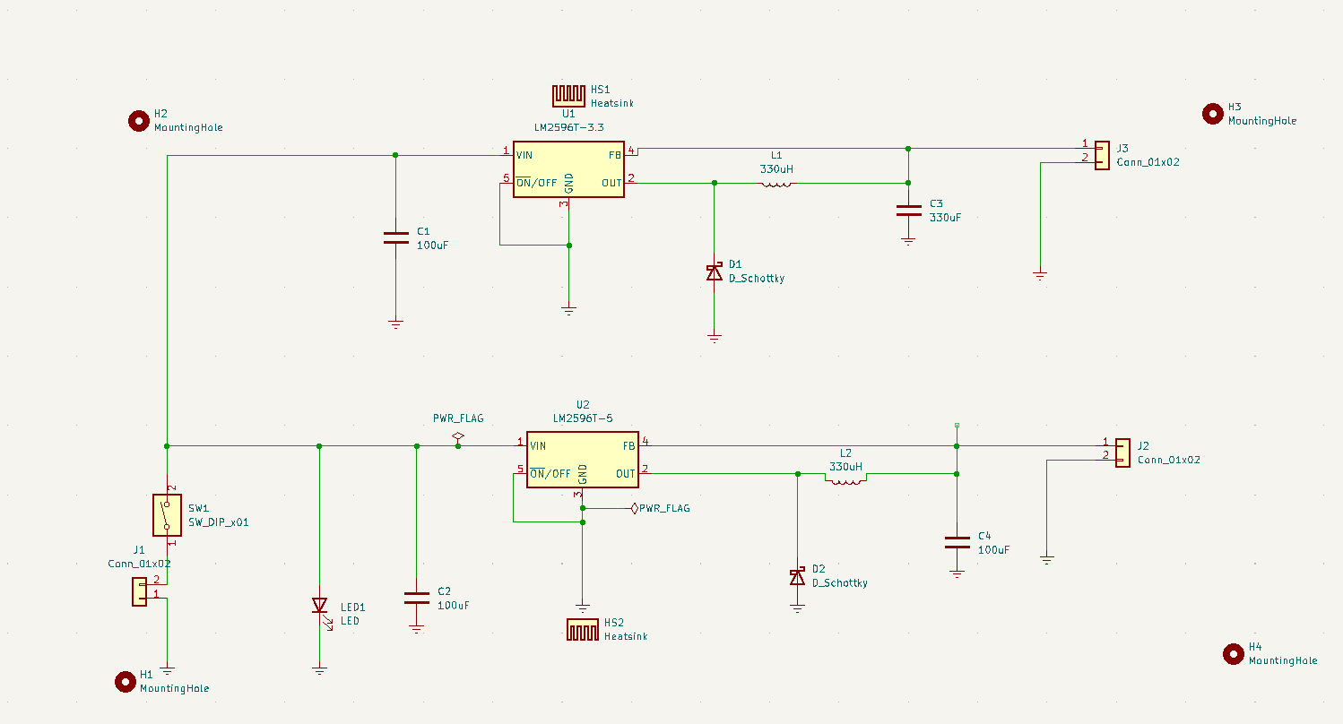
Schematic diagram

Slide 5
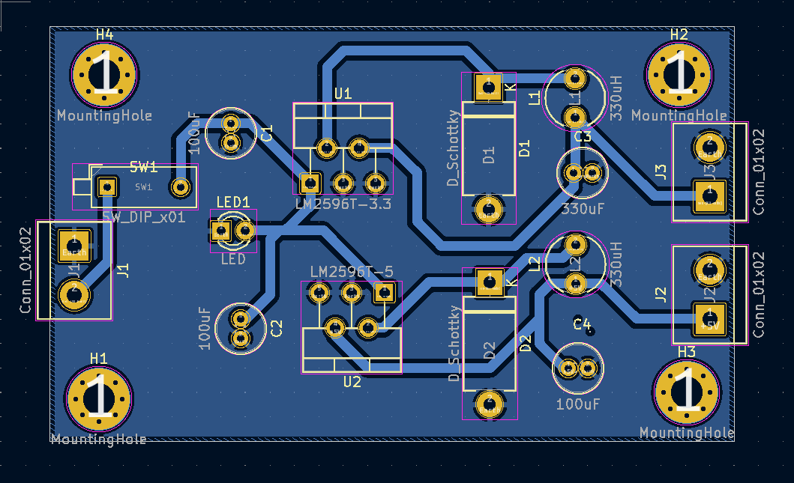
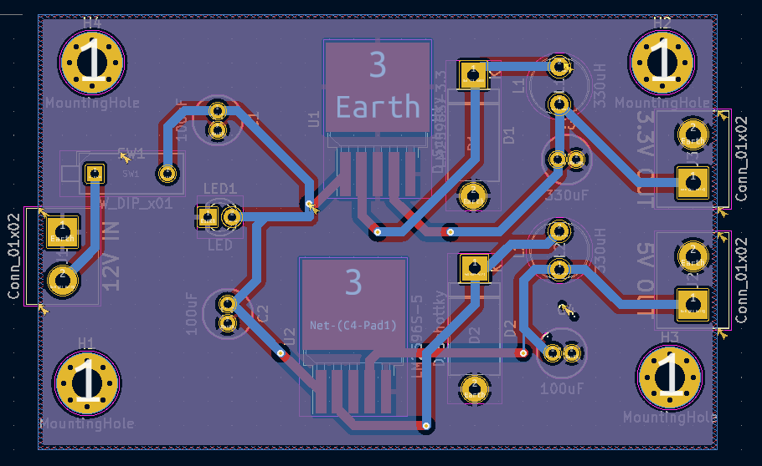
PCB DESIGN
LM 2596S
LM 2596T

Slide 6
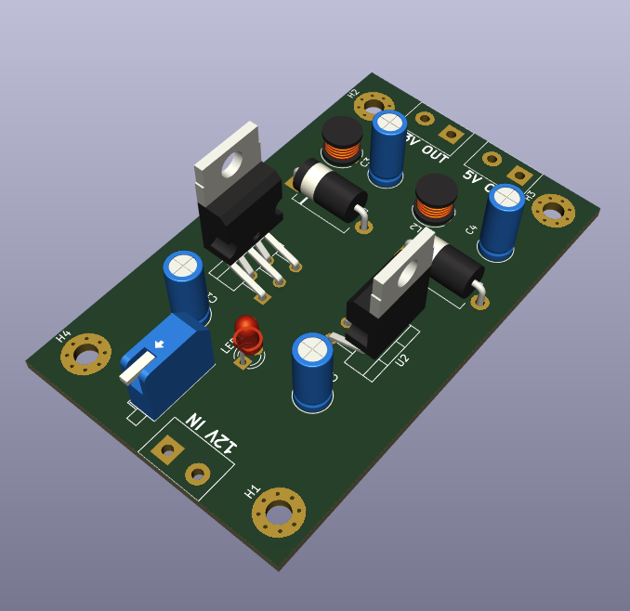
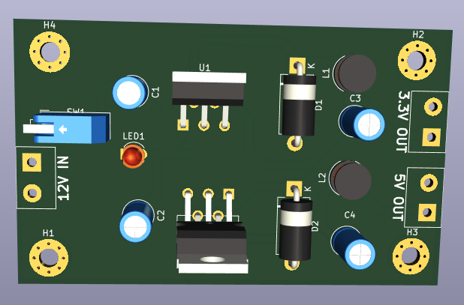
3D MODEL
LM2596T

Slide 7
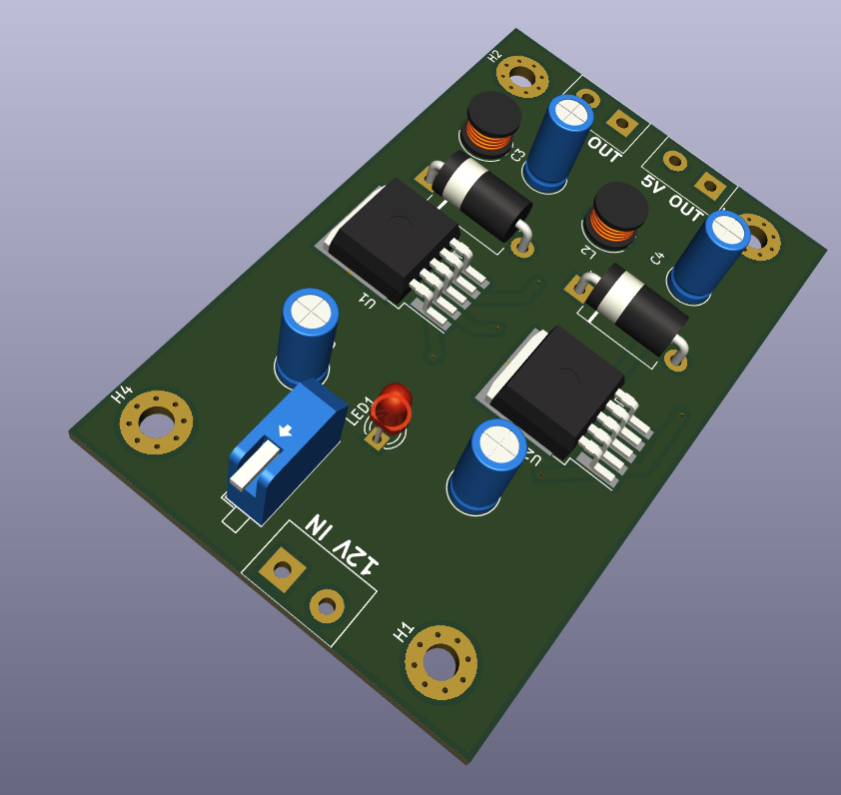
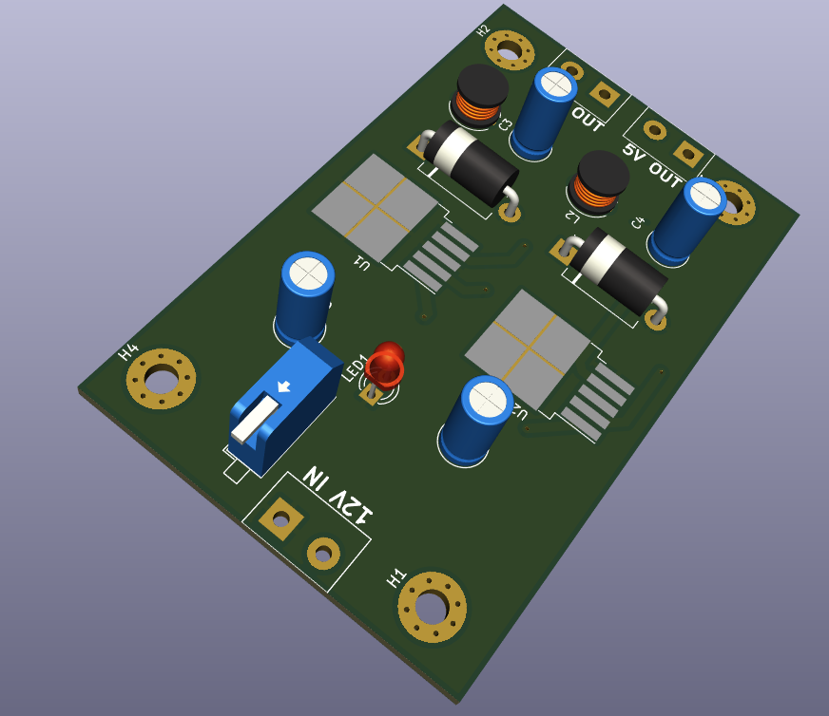
3d design

Slide 8
Price of components
ITEM | QUANTITY | PRICE | TOTAL
LM 2596 5.0 | 1 | KSH 50 | KSH 50
LM 2596 3.3 | 1 | KSH50 | KSH 50
100 μF Capacitor | 2 | KSH 5 | KSH 10
330 μH Inductor | 2 | KSH25 | KSH 50
Schottky diode | 2 | KSH 20 | KSH 40
Screw block connectors 1*2 | 4 | KSH 15 | KSH 60
LED light(12v) | 1 | KSH 50 | KSH 50
330μF Capacitor | 1 | KSH 20 | KSH 20
 |  |  | KSH 270

Slide 9
OBJECTIVES FOR THE NEXT WEEK
Purchase the necessary components.
Fabricate the PCB
Mount and solder the components.
Test the Buck Converter

Slide 10
THANK YOU

